Slide 1

JavaScript Overview and Syntax
Notes:
Welcome everyone. In this lecture, we’ll explore the basics of the JavaScript language — its origins, data types, and core concepts. By the end, you’ll be able to describe JavaScript primitives and objects and understand how it brings behavior to web pages

Slide 2
What is JavaScript?
Scripting language based on ECMAScript standard
Initially designed for Netscape Navigator
Supported by virtually all browsers
Enables dynamic and interactive web content
Notes:
JavaScript was originally created for the Netscape browser but quickly became a standard. Even though its name includes “Java,” it’s unrelated to the Java programming language. When embedded in browsers, JavaScript adds interactivity and dynamic content to static HTML.

Slide 3
How JavaScript Works
JavaScript acts on the Document Object Model (DOM)
It allows dynamic updates to web page content
Works with server programming through Ajax (Asynchronous JavaScript and XML)
JSON is now commonly used instead of XML
Notes:
The DOM represents the structure of a web page. JavaScript interacts with this model to modify elements. Ajax architecture combines HTML, CSS, and JS to create responsive web apps. Today, JSON often replaces XML for data exchange.

Slide 4
JavaScript Data Types
Primitive Types (5):
Number
String
Boolean
Null
Undefined
Objects: All other data types are objects.
Notes:
JavaScript has five primitive data types. Everything else—like arrays, dates, and functions—is an object. Primitives are immutable values, not objects.

Slide 5
The Number Types
Represents integers and floating-point values
Includes NaN and Infinity
Supports decimal, octal (0 prefix), and hexadecimal (0x prefix)
Internally stored as 64-bit floating point
Notes:
All numbers in JavaScript use the same 64-bit format — there’s no distinction between integers and floats. Remember: 020 (octal), 0x10 (hexadecimal), and 16 (decimal) all represent the same value.

Slide 6
Strings
Delimited by 'single' or "double" quotes
No inherent methods in primitive form
Can be wrapped with a String object
Notes:
tring literals are basic text values. When you need methods like .toUpperCase() or .length, JavaScript automatically wraps primitives with their corresponding object types.

Slide 7
Wrapper Objects
Object versions of primitives: Number, String, Boolean
Allow methods like valueOf() and toString()
Created using the new keyword
Example:
let s = new String("hello");
typeof s; // "object"
s.valueOf(); // "hello"
Notes:
Wrapper objects let you treat primitive values like objects, enabling conversions between literals and objects. For example:

Slide 8

The typeof Operator
Used to determine a variable’s data type
Example:
Notes:
The typeof operator helps you inspect data types at runtime. It’s useful for debugging and type checking, especially in loosely typed code.

Slide 9
Arrays
Specialized objects for storing ordered data
Zero-based indexing
Dynamic resizing with the length property
Declared using:
Constructor: new Array(1, 2, 3)
Literal: [1, 2, 3]
Notes:
Arrays are flexible containers that can grow or shrink as needed. Always prefer array literals ([]) over constructors for readability and performance.

Slide 10
The Date Object
Created using new Date([parameters])
Without parameters → current date/time
Displays as string when output
Accepts both string and numeric parameters
Notes:
The Date object provides date and time utilities.

Slide 11

The Date Object
You can convert a Date to string with .toString() or manipulate it with methods like .getFullYear().
Notes:
The Date object provides date and time utilities.

Slide 12
Error Handling
Errors are represented by Error objects
Common properties:
name
message
Common error types:
RangeError
ReferenceError
SyntaxError, etc.
Custom errors can be created via new Error("message")
Notes:
JavaScript provides built-in error objects for exception handling. You can use try...catch blocks to catch these exceptions or create custom error messages for debugging.

Slide 13
Variables and Control Statements
Notes:
In this session, we’ll explore how JavaScript stores data using variables and how control structures like conditionals and loops help define program logic.

Slide 14
Variables in JavaScript
Variables store data values
Declared using:
var
let
const
Names must start with a letter, _, or $
Notes:
Variables are like containers for storing data in memory. JavaScript is case-sensitive, so Total and total are two different variables. Remember: let and const were introduced in ES6 for better scope control.
===
This table summarizes how each keyword behaves.
var is old and function-scoped.
let is block-scoped and can be reassigned.
const defines constants, which can’t be reassigned. Prefer let or const in modern code.

Slide 15

Hoisting
Variable declarations are moved to the top of their scope
But initializations are not
Example:
Notes:
This example demonstrates hoisting: var x is declared before use but not initialized until line 2. Using let or const avoids these pitfalls — they are not hoisted in the same way.

Slide 16

Dynamic Typing
JavaScript is loosely typed
Variable type determined at runtime
You can reassign different types:
Notes:
Unlike Java or C++, JavaScript doesn’t enforce variable types. A variable can hold any kind of value. While this offers flexibility, it can also cause logic errors — so careful type checking is recommended.

Slide 17

Type Conversion
Implicit: JS automatically converts types
Explicit: Use built-in functions like
Number(), String(), Boolean()
Notes:
Type coercion happens automatically in many operations. Be careful: the + operator concatenates strings but adds numbers. When in doubt, use explicit conversion to control the result.

Slide 18
Control Statements Overview
Control flow determines how code executes
Categories:
Conditionals (if, switch)
Loops (for, while, do-while)
Jump statements (break, continue)
Notes:
Control structures allow your program to make decisions and repeat actions. They are the backbone of logical flow in JavaScript programs.

Slide 19
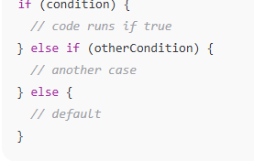
The if Statement
Notes:
The if statement evaluates a condition. If true, the code inside runs. Use else if for multiple cases and else for fallback behavior.

Slide 20
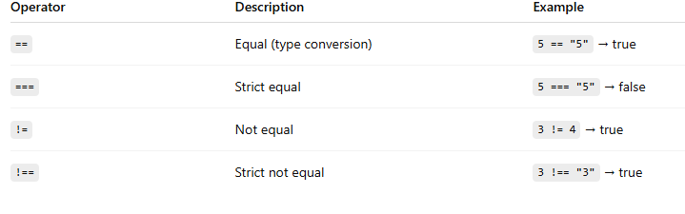
Comparison Operators
Notes:
Always prefer strict equality (===) to avoid unintended type conversions. The loose equality operator (==) can lead to subtle bugs.

Slide 21
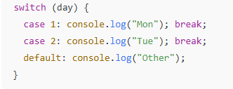
The switch Statement
Notes:
A switch statement tests a value against multiple cases. Use break to stop execution after a match. The default clause runs if no case matches.

Slide 22

Loops
for loop: when number of iterations known
while loop: when condition checked before running
do...while: runs at least once
Notes:
Loops repeat a block of code while a condition is true. Use the right loop depending on whether you know the iteration count in advance.

Slide 23
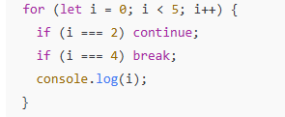
Loop Control: break and continue
break: exits the loop immediately
continue: skips current iteration
Example:
Notes:
break is used when a condition is met and you want to stop looping. continue skips the rest of the current loop iteration and moves to the next one.

Slide 24
The Ternary Operator
let result = (score >= 60) ? "Pass" : "Fail";
Notes:
The ternary operator is a shorthand if...else expression. It’s concise and great for simple conditions. However, avoid nesting multiple ternaries — they hurt readability.

Slide 25
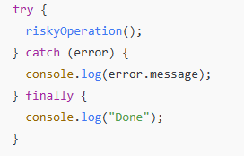
Error Handling with try...catch
Notes:
try...catch lets you handle runtime errors gracefully. The finally block always runs, whether an error occurs or not — great for cleanup code.

Slide 26
Introduction to Functions and Types of Functions in JavaScript
Notes:
Welcome to Introduction to Functions and Types of Functions in JavaScript. By the end of this lesson, you will be able to:
Define the concept of functions in JavaScript
Differentiate between parameterized and non-parameterized functions
Identify the main ways to define functions
Recognize various types of functions in JavaScript
===========

Slide 27
What is a Function?
A function is a reusable block of code.
Can be defined once and executed multiple times.
Helps organize, encapsulate, and reuse logic.
Improves structure, readability, and maintainability.
function greet() {
console.log("Hello, World!");
}
greet(); // Calling the function
Notes:
Functions are at the heart of JavaScript programming. They let you write code once and use it wherever needed. This reduces repetition and makes your programs cleaner and easier to debug.
============
To declare a function, use the function keyword followed by the function name, parentheses, and curly braces containing the code. When you call the function using its name and parentheses, it executes the code inside its block.

Slide 28
Parameterized vs Non-Parameterized Functions
Type | Description | Example
Non-parameterized | No input values required | function greet() { console.log("Hi"); }
Parameterized | Accepts input values (parameters) | function add(a, b) { return a + b; }
Notes:
Speaker Notes: Non-parameterized functions perform tasks using internal logic only. Parameterized functions, on the other hand, can accept input values—called parameters—making them more flexible and reusable.

Slide 29
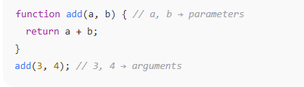
Parameters vs Arguments
Notes:
Parameters are placeholders in the function definition. Arguments are the actual values you pass when calling the function. In this example, a and b are parameters, while 3 and 4 are arguments.

Slide 30

Two Ways to Define Functions
Function Declaration
Function Expression
Notes:
There are two main ways to define functions in JavaScript. A function declaration is the traditional method. A function expression defines a function and assigns it to a variable—this approach is useful for anonymous or conditional function definitions.

Slide 31
Types of Functions in JavaScript
Named Function
Immediately Invoked Function Expression (IIFE)
Arrow Function
Anonymous Function
Notes:
JavaScript provides several function types, each with its own use case. Let’s explore each one in detail to understand when and how to use them.

Slide 32

Immediately Invoked Function Expression (IIFE)
Executes right after creation
Helps avoid global variable conflicts
Notes:
An IIFE is a function that runs immediately after it’s defined. It’s often used to keep variables private and prevent polluting the global scope—especially useful in older JavaScript before modules became common.

Slide 33
Arrow Functions
const add = (a, b) => a + b;
Introduced in ES6
Shorter syntax
No this binding
Notes:
Arrow functions provide a concise way to write small, simple functions. They’re great for callbacks and inline functions. However, they don’t have their own this context, so avoid using them as object methods.

Slide 34

Anonymous Functions
Functions without a name
Often used as arguments or assigned to variables
Notes:
Anonymous functions are used when you don’t need to reuse the function elsewhere. They’re common in event handlers, callbacks, and higher-order functions.

Slide 35
ECMAScript Function Syntax and Return Statement
Notes:
Welcome to ECMAScript Function Syntax and Return Statement. By the end of this lesson, you’ll be able to:
Describe ECMAScript and its specifications
Define the arrow function and identify its categories
Explore the purpose and behavior of the return statement with examples

Slide 36
What is ECMAScript (ES)?
ECMAScript (ES) is a standardized scripting language specification.
Serves as the foundation for scripting languages such as JavaScript.
Defines core language features for consistent behavior across platforms.
Maintained by ECMA International.
Notes:
ECMAScript provides the official blueprint that scripting languages like JavaScript follow. It ensures that code behaves the same way across different browsers and environments. The ECMA International organization updates and maintains the standard.

Slide 37
ECMAScript Specification
Syntax and data types
Control structures
Object manipulation rules
Guidelines for consistent, interoperable scripts
Notes:
The ECMAScript specification defines how scripting languages should handle syntax, data types, and object manipulation. This allows developers to write JavaScript that runs consistently across browsers and platforms, like Chrome, Node.js, or Edge.

Slide 38
Introduction to Arrow Functions (ES6)
Introduced in ECMAScript 6 (ES6)
Provides a concise and readable syntax
Uses the “fat arrow” (=>) notation
Ideal for simple, one-line functions
Notes:
Arrow functions are a newer syntax that makes JavaScript functions shorter and cleaner. They’re particularly handy for inline functions or callbacks, such as when working with arrays or event listeners.

Slide 39
Arrow Function Syntax
const add = (a, b) => a + b;
No function keyword
Implicit return for one-liners
More compact than traditional syntax
Notes:
Unlike traditional functions, arrow functions don’t need the function keyword. They automatically return the result if the body is a single expression, making them perfect for short logic statements.

Slide 40
Types of Arrow Functions
Type | Description | Example
Parameterized | Takes input values | const add = (a, b) => a + b;
Non-parameterized | Takes no input | const greet = () => console.log("Hello!");
Notes:
Arrow functions can either accept parameters or operate without any. A parameterized arrow function performs calculations or actions based on input, while a non-parameterized function runs predefined logic.

Slide 41
Arrow vs Traditional Functions
Feature | Arrow Function | Traditional Function
Syntax | Short and compact | Verbose
Uses function keyword | ❌ No | ✅ Yes
Has this context | ❌ No | ✅ Yes
Best for | Short callbacks | Complex logic / named functions

Slide 42

The Document Object Model (DOM) and JavaScript APIs
Notes:
Welcome to Part 3 of our JavaScript lecture series. In this session, we’ll explore how JavaScript interacts with the structure of a web page through the Document Object Model, or DOM, and how to use APIs to manipulate page elements and external resources.

Slide 43
What is the DOM?
DOM = Document Object Model
Tree-like structure representing an HTML document
Each node is an object: elements, attributes, text
JavaScript can access and modify these nodes dynamically
Notes:
The DOM acts as a bridge between HTML and JavaScript. Think of it as a tree where every HTML tag becomes a node. You can use JavaScript to modify, remove, or add these nodes in real time, making web pages interactive.

Slide 44
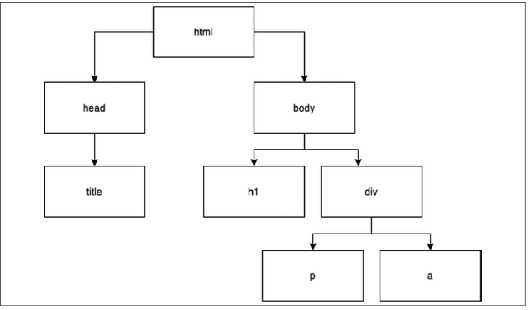

Slide 45
The DOM Tree Structure
document is the root of the DOM
Branches contain:
Element nodes (<div>, <p>)
Text nodes (actual text)
Attribute nodes (like class, id)
Notes:
When you load an HTML document, the browser parses it into a structured hierarchy. Each node type can be accessed using JavaScript, allowing fine-grained control over the page layout and content.

Slide 46
Attribute | Description | Used On
id | Gives an element a unique identifier (e.g., id="age") | All elements
name | Assigns a custom name to an element | input, button, form, etc.
class | Adds metadata for styling or JS manipulation | Most body elements
value | Sets the initial value of an element | button, input, li, etc.
style | Applies inline CSS styles | All elements

Slide 47
Accessing Elements
Common methods:
document.getElementById("id");
document.getElementsByClassName("class");
document.getElementsByTagName("tag");
document.querySelector("selector");
document.querySelectorAll("selector");
Notes:
These methods are used to locate elements in the DOM. querySelector and querySelectorAll use CSS-style selectors, which makes them powerful and modern. Example: document.querySelector("#menu li.active") selects an active list item inside the menu.

Slide 48
Manipulating Elements
Change
Change text or HTML:
element.textContent = "Hello";
element.innerHTML = "<b>Welcome</b>";
Modify
Modify attributes:
element.setAttribute("src", "image.jpg");
Add or remove
Add or remove classes:
element.classList.add("highlight");
element.classList.remove("hidden");
Notes:
JavaScript lets you modify content dynamically. Use textContent when inserting plain text and innerHTML for HTML markup. classList is the modern, safe way to toggle visual styles.

Slide 49
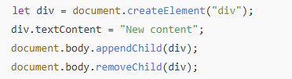
Creating and Removing Elements
Notes:
This shows how to create new elements and add them to the DOM tree. You can also remove existing nodes dynamically, allowing your scripts to restructure the page in real time.

Slide 50
Handling Events
JavaScript reacts to user actions using events
Common events:
onclick
onmouseover
onchange
onkeydown
Notes:
Event-driven programming is a key part of JavaScript. You can make web pages interactive by responding to user input such as mouse clicks, keypresses, and form changes.

Slide 51

Event Listeners
Notes:
The addEventListener method is the modern way to attach events. It separates HTML from JavaScript, keeping your code clean and maintainable. You can also remove events using removeEventListener() when no longer needed.

Slide 52

The this Keyword in Events
Notes:
Inside an event handler, this refers to the element that triggered the event. In this example, the element’s text color changes to red when clicked.

Slide 53
Common DOM API Properties
Property | Description
.innerHTML | Gets or sets HTML content
.textContent | Gets or sets plain text
.value | Gets value of input or textarea
.style | Access or modify inline CSS
.classList | Manage element classes
Notes:
These are the most frequently used DOM properties. They allow easy updates to text, form values, and styles directly through JavaScript.

Slide 54
The Browser Object Model (BOM)
Extends JavaScript’s access beyond the DOM
Provides interaction with browser features:
window
navigator
screen
location
history
Notes:
The BOM is a collection of objects representing the browser environment itself. For instance, window.location manages URLs and redirects, while navigator gives information about the user’s browser.

Slide 55

Example: Using BOM APIs
Notes:
This example uses the BOM to:
Display the current page URL
Log browser details
Trigger an alert popup
Although simple, these methods are foundational for client-side web interaction.

Slide 56

Timers and Intervals
Notes:
setTimeout runs code once after a delay, while setInterval repeats execution at fixed intervals. Always clear intervals with clearInterval() to avoid performance issues.

Slide 57
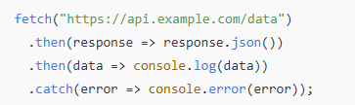
Using the Fetch API
Notes:
The Fetch API allows JavaScript to make network requests to external servers. It replaces older methods like XMLHttpRequest. You can use it to fetch JSON data, images, or other resources asynchronously.

Slide 58
Client-Side Scripting and Interactivity
Notes:
In this session, we’ll explore how JavaScript operates on the client side — that is, in the user’s browser — and how it creates interactive, dynamic web experiences.

Slide 59
What is Client-Side Scripting?
Code runs in the browser, not on the server
Enhances user experience by:
Immediate feedback
Dynamic updates
Reduced server load
Examples: Form validation, animations, interactive menus
Notes:
Client-side scripting enables interactive web pages that respond instantly to user actions. Instead of waiting for a page reload, users see updates instantly — like typing suggestions, live validation, or image sliders.

Slide 60
Client vs. Server Side
Feature | Client-Side (JS) | Server-Side (PHP, Node.js, etc.)
Execution | In browser | On server
Language | JavaScript | Python, PHP, Java, etc.
Access to system | Limited (sandboxed) | Full server access
Speed | Fast (no server trip) | Slower (network delay)
Notes:
Both client-side and server-side scripts are important, but they serve different purposes. Client-side code handles interactivity, while server-side code manages data and security.

Slide 61
Embedding JavaScript in HTML
Inline
<button onclick="alert('Hi')">Click Me</button>
Internal
<script>
alert("Hello");
</script>
External
<script src="script.js"></script>
Notes:
It’s best practice to place scripts in external files to improve organization and caching. Inline and internal scripts are fine for small examples or quick tests.

Slide 62

The Role of the window Object
Represents the browser window
Global object — every variable or function is a property of window
Notes:
window is the top-level object in the browser environment. Even when you omit window., the code still references it implicitly.

Slide 63


User Interaction Examples
Alerts and Prompts
Confirm Dialog
Notes:
These built-in dialogs are simple ways to interact with users. Though not very customizable, they’re handy for quick confirmations or debug prompts.

Slide 64
DOM Events for Interactivity
Common event types:
Mouse events: click, dblclick, mouseover
Keyboard events: keydown, keyup
Form events: submit, change, focus, blur
Window events: load, resize, scroll
Notes:
Events are central to client-side scripting. You attach event handlers to DOM elements to define how your page reacts to user input.

Slide 65
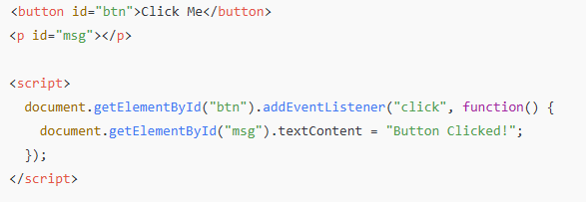
Example: Dynamic Content Change
Notes:
Here, the script waits for the button to be clicked, then updates a <p> element. This demonstrates the event-driven nature of client-side JavaScript.

Slide 66
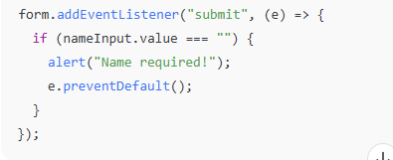
Working with Forms
Validate input before submission
Prevent empty or invalid data
Example:
Notes:
Form validation is one of the most common uses of client-side scripting. By checking input before submission, you enhance usability and reduce unnecessary server requests.

Slide 67

Updating CSS Dynamically
Notes:
JavaScript can directly manipulate styles. You can change CSS properties inline or toggle predefined CSS classes dynamically for animations or themes.

Slide 68

Animations and Transitions
Use JavaScript to trigger CSS animations
Example:
Or create custom animations using setInterval() or requestAnimationFrame()
Notes:
Animations make pages lively and engaging. Use CSS animations for performance, and JavaScript for dynamic control, like starting or pausing based on user actions.

Slide 69

Working with Timers
Notes:
setTimeout and setInterval are useful for delayed or repeated actions. You can build slideshows, countdowns, or notifications easily using these functions

Slide 70

AJAX and Dynamic Data
AJAX = Asynchronous JavaScript and XML (now usually JSON)
Fetch data from server without reloading
Example:
Notes:
AJAX allows web pages to update data dynamically. Instead of reloading the page, you can update parts of it — like a news feed or chat window.

Slide 71
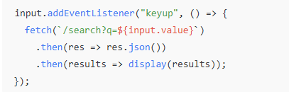
Real-World Example: Live Search
Notes:
This is the basis of autocomplete search boxes. As the user types, JavaScript sends a request and updates the UI instantly — no reload needed.

